Slide 1
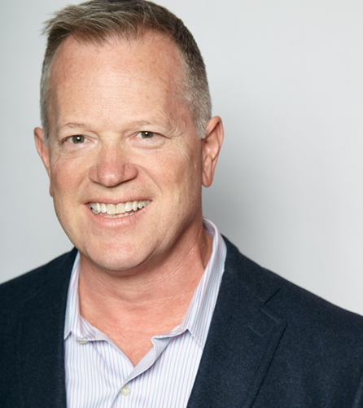
Meet the Seattle Mentors
Carla Carrell
Director of Government Affairs
Comcast
Carla is responsible for regulatory, franchising and public policy matters for East and North King, Snohomish and Whatcom local franchise authorities. In addition, she is responsible for external affairs influencer initiative, signature events programs, executive communications initiatives and outage communications planning.
Doug George Senior Director
Turner Networks Doug is a 25 year veteran of the cable industry – his 3rd and final career – and has held positions in marketing, affiliate ad sales and distribution at MTV Networks/Viacom, Scripps Networks and now Turner Content Distribution where he is responsible for the business relationships between Turner and all distributors in the Midwest and West.
Kevin Harrison
Vice President, Finance and Business Operations
Comcast
Kevin Harrison serves as Vice President, Finance and Business Operations for Comcast’s Washington Region. He has been with Comcast for more than 16 years, serving as the Vice President of Finance and Business Operations for the Oregon/SW Washington Region prior to re-joining Washington in 2016, where he previously worked in a Sr. Director position from 2005 to 2012.

Slide 2
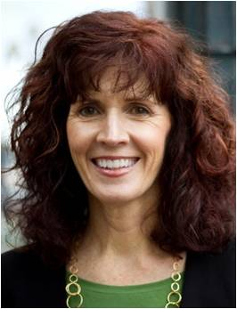
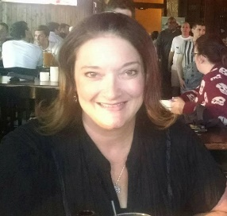
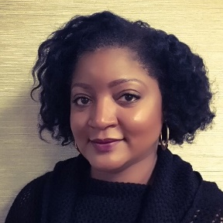
Meet the Seattle Mentors
Vicky Oxley
Vice President of Sales & Marketing
Comcast
Vicky joined Comcast in 2015 from Frontier Communications, where she held the position of VP and General Manager for the Washington Territory. In her current role, Vicky works with the Senior Leadership Team to drive the residential growth plan for the Washington Region, overseeing all aspects of sales including Comcast Stores, Direct and Retail Sales, and Multiple Dwelling Contracts.
Cindy Riccardo
Sr. Regional Manager of Research
Comcast Spotlight
Cindy joined Comcast in 2005 as a Media Manager, first for the Washington region, and then beginning in 2010, for the West Division and most recently as Sr. Regional Manager of Research in the Spotlight division. Prior to joining Comcast, Cindy held various advertising and marketing roles including Media Director at Car Toys, Media Manager DDB Seattle and corporate media manager at Nordstrom.
Todd Sloan
Director of Local Sales
Comcast Spotlight
Todd has spent the last 26 years navigating the media landscape in both Local, Regional and National arenas with the last 7 years as Director of Local Sales at Comcast Spotlight.
Tabatha Stephens
Director of Campaign Management
Comcast Spotlight
Tabatha has been with Comcast Spotlight for 16 years, her most recent position being Director of Campaign Management for the NW, SW and California Regions. In this role Tabatha is responsible for providing leadership and direction in all operational aspects of advertising post-sales activity.

