Slide 1
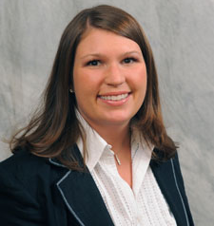
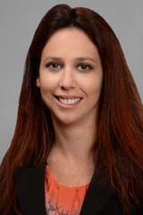
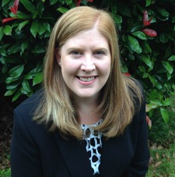
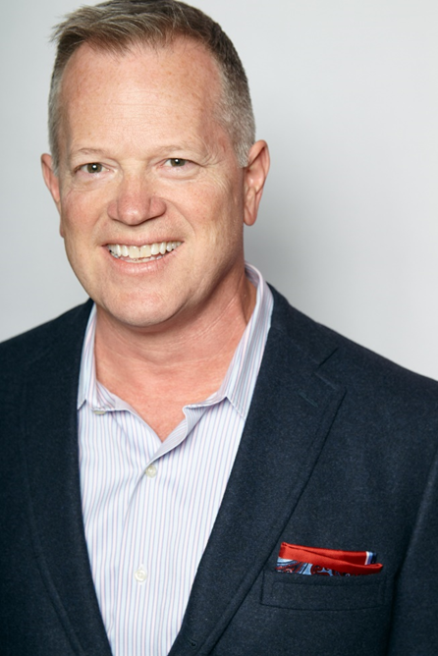
Meet the Portland Mentors
Megan Bishop
Vice President of Finance & Accounting
Comcast
Megan Bishop is the Vice President of Finance & Accounting for Comcast’s Oregon & SW Washington Region. In this role, Megan oversees the finance, accounting, capital, business assurance, supply chain, and facilities teams for the region.
Kristeen Cominiello
Vice President of Sales and Marketing
Comcast Kristeen joined Oregon/SW Washington Region as the Vice President of Sales and Marketing in May 2016. In this role she leads a team of 250 sales leaders and sales professionals; Sales and Marketing Operations, Outside Sales, Retail, Indirect Retail, and Xfinity Communities.
Julie Danielson
Vice President, Billing Customer Care Center
Charter
Julie joined Charter Communications in January 2016. Currently she serves as Vice President of the Billing Customer Care Center in Vancouver, Washington.
Doug George Senior Director
Turner Networks Doug is a 25 year veteran of the cable industry – his 3rd and final career – and has held positions in marketing, affiliate ad sales and distribution at MTV Networks/Viacom, Scripps Networks and now Turner Content Distribution where he is responsible for the business relationships between Turner and all distributors in the Midwest and West.

Slide 2
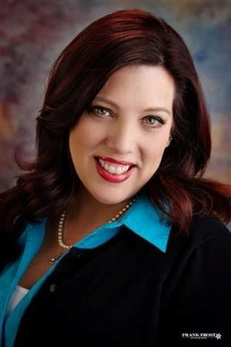
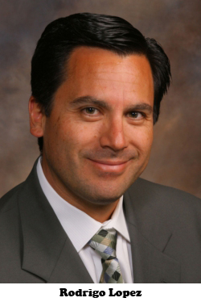
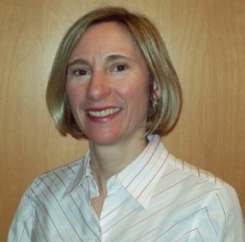
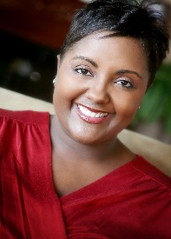
Meet the Portland Mentors
Jane Hougnon
Director of Retail Sales
Comcast
Jane Hougnon is the Director of Retail Sales for Comcast’s Oregon and SW Washington Region. In this role, Jane oversees all sales and operations for the retail stores in the region. Jane began her career with Comcast in 2006 in Santa Fe, NM, as the Customer Service Manager.
Rodrigo Lopez
Regional Senior Vice President – Oregon & SW Washington
Comcast
Rodrigo Lopez is the Regional Senior Vice President for Comcast’s Oregon and SW Washington operations, with general management responsibility for a subscriber base of more than 600,000 and more than 1,500 employees. Lopez has been with Comcast for more than 20 years, and he began his career as a part time Customer Account Executive at Comcast’s former Orange County, California system.
Kathleen Martin
Director of Human Resources
Charter Kathleen Martin is the Director of Human Resources for Field Operations for the Pacific Northwest of Charter Communications. She has been with Charter since October 2001. She has over 20 years of human resources management experience, including experience in the high tech and alarm services industries.
Danielle Wade
Area Vice President of Field Operations
Charter
Danielle Wade is the Area Vice President of Field Operations for the Pacific Northwest area of Charter Communications. In her role, she is responsible for all field-related activity including fulfillment, maintenance, construction and dispatch and work force management for three states including Washington, Oregon and Idaho.

