Slide 1
WOMEN IN CABLE TELECOMMUNICATIONS 2016 Winter Retreat
Creating Leaders. Together.

Slide 2
WICT Retreat
Let’s Warm Up!
What’s your name?
What’s your board role?
If you’ve done DISC or Insights, what your dominant profile?
If you’ve been on the board, what have you learned (new skills, self-awareness, exposure, etc.)?
How can our team help with your career advancement in 2017?

Slide 3
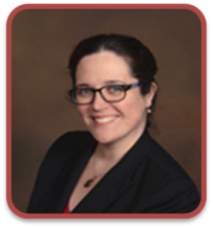
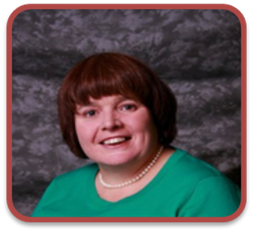
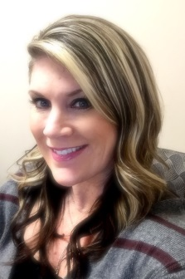
2017 Pacific Northwest Chapter Leaders
Joni Pierce
WICT: President
Comcast:
Director, Business/Sales Operations
Kathleen Martin
WICT: Co-Vice President
Charter:
Director of Human Resources
Whitney Joly
WICT: Co-Vice President
Comcast Spotlight:
Sr. Manager, Marketing
Abbie O’Dell
WICT: Secretary
Charter:
Manager, Regional Training Delivery
Andrea Kekel Costello
WICT: Past President
Comcast:
Media Manager, West Division
Jacque Hillsbery
WICT: Co-Treasurer
Comcast:
Manager, Business Operations
Pekio Vergotis
WICT: Co-Treasurer
Comcast:
Sr. Analyst, Business Assurance
Jennifer Fischer
WICT: Co-Membership
Comcast:
Manager, InDirect Retail Sales
Tracee Linn
WICT: Co-Membership
Charter:
Carrier Account Manager CB
Ashley Powers
WICT: Outreach
Comcast:
Specialist, Marketing

Slide 4
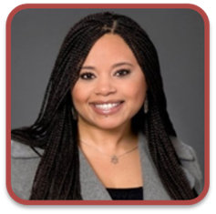
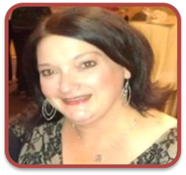
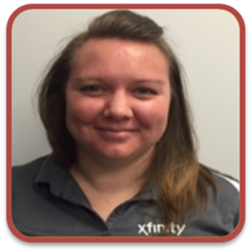
2017 Pacific Northwest Chapter Leaders
Kindra Bosch
WICT: Co- Programming
Comcast:
Manager, Engineering
Stephanie Kenison
WICT: Co- Programming
Comcast:
Specialist, Marketing
Dyana Langley Robinson
WICT: Co-Sponsorship
Comcast:
Director, Project Management
Cindy Riccardo
WICT: Co-Sponsorship
Comcast: Manager, Media Marketing
Marian Jackson
WICT: Director At Large
Charter:
Director, Government Relations
Jan Wachholz
WICT: Co-Communications & Web
Comcast:
Manager, MultiCultural Marketing
Mary Rose Breskovich
WICT: Co-Communications & Web
Comcast:
Specialist, Marketing
Anita Ewald
WICT: Co-Mentoring
Comcast:
Manager, Engineering
Savanah Service
WICT: Co-Mentoring
Comcast:
Assistant Store Manager
Christie Wolgamott
WICT: Director At Large
Comcast Spotlight: Marketing Manager

Slide 5
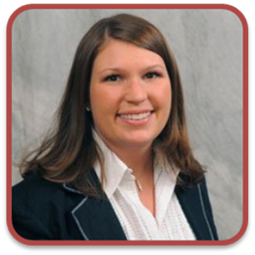
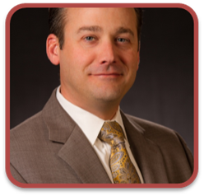
2017 Pacific Northwest Chapter Leaders
Danielle Wade
WICT: Advisor
Charter:
Area Vice President
Megan Bishop
WICT: Advisor
Comcast:
Vice President
Finance & Accounting
Rodrigo Lopez
WICT: Advisor
Comcast :
Region
Senior Vice President
Drew Bruno
WICT: Advisor
Comcast Spotlight:
Regional
Vice President

Slide 6
Creating Leaders. Together.
2016 Highlights

Slide 7
Creating Leaders. Together.
How are we communicating?

Slide 8
WICT Retreat
How are we communicating?
Monthly Board Meetings?
Monthly Pres/VP Pre-Meetings
Quarterly strategic meetings
Emails – subject heading starts with WICT (or should we innovate?)
Storing documents on WICT Connects (or should we innovate?)

Slide 9
Creating Leaders. Together.
National Conference

Slide 10
Creating Leaders. Together.
Transitions

Slide 11
Creating Leaders. Together.
Financial Review

Slide 12
2016 WICT Pacific NW Chapter Financial Overview
Income
National Allocations $ 5,804.51
Events $ 9,335.00
Sponsorships $ 2,250.00
Book Club $ 2,360.00
Total Revenue $19,749.51
Expenses
Event Fees $ 8,610.78
Book Club $ 1,208.40
Mentor Program $ 492.76
Conf. Scholarships $ 4,786.60
Board Event $ 439.86
PAR $ 894.38
2015 Expenses $ 633.59
Total Expenses $17,066.37
Net Income as of 11/18 $2,683.14
Cash in Hand as of December 31st,2015 $12,630.50
Cash in Hand as of Nov , 2016 $15,313.64

Slide 15
Creating Leaders. Together.
Financial Review

Slide 16
Creating Leaders. Together.
Transitions

Slide 17
Creating Leaders. Together.
2017 PLANNING

Slide 18
WICT Mid-Year Retreat
Mid-year planning Session
Location: Centralia McMenamin’s
Let’s pick a date!
Tuesday, May 9th
Tuesday, May 16th
Wednesday, May 17th

Slide 19
WICT Mid-Year Retreat
Thank you!
We hope to see you at:
Raven & Rose – Rookery Bar
1331 SW Broadway, Portland
Reservation 4:30pm

