Slide 1
WOMEN IN CABLE TELECOMMUNICATIONS 2016 Retreat
Creating Leaders. Together.

Slide 2
WICT Retreat
Let’s Warm Up!
What’s your name?
What’s your board role?
What have you been working on so far?
If you’ve done DISC or Insights, what your dominant profile?
What’s something that you are working on from a personal development perspective?

Slide 3
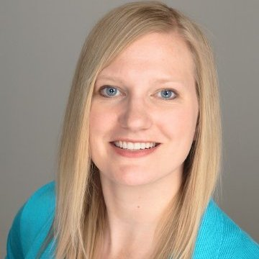
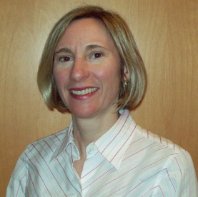
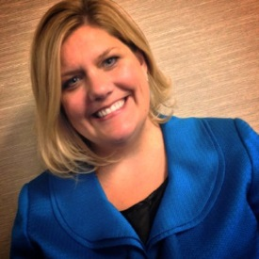
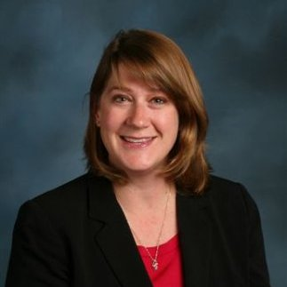
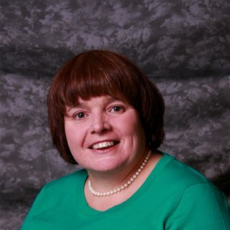
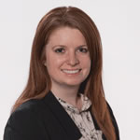
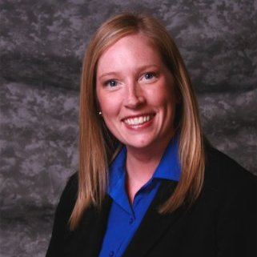
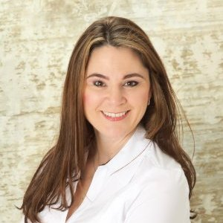
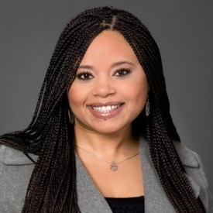
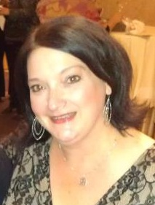
WICT Board – Pacific Northwest Chapter
Joni Pierce
President
Kathleen Martin
Co-Vice President
Whitney Joly
Co-Vice President
Wendy Mizutani
Secretary
Jacque Hillsbery
Treasurer
Stephanie Kenison
Co-Programming
Ashley Powers
Co-Programming
Jennifer Fischer
Co-Membership
Pekio Vergotis
Co-Membership
Dyana Langley-Robinson
Co-Sponsorship
Cindy Riccardo
Co-Sponsorship

Slide 4
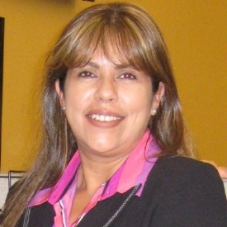
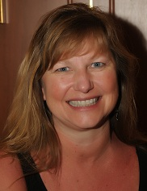
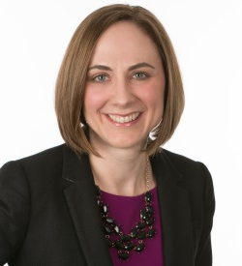
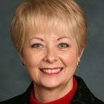
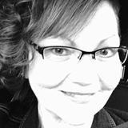
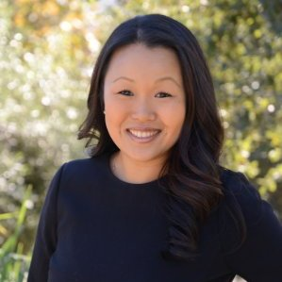
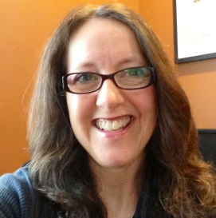
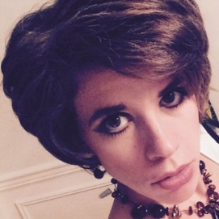
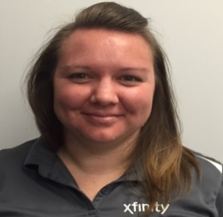
WICT Board – Pacific Northwest Chapter
Beatriz Imel
Outreach
Jan Wachholz
Communication
Christie Wolgamott
Webmaster
Marian Jackson
Advisor
Theresa Smith
Advisor
Kim Weiss
Advisor
Andrea Costello
Past President
Kindra Bosch
Co-Mentoring
Savanah Service
Co-Mentoring

Slide 5
Meet The Board
Title | Name | Company | Title
President | Joni Pierce | Comcast | Director, Business Operations, Comcast Business Class
Vice President - Co | Kathleen Martin | Charter | Director of Human Resources
 | Whitney Joly | Comcast Spotlight | Senior Marketing Manager, WA
Treasurer | Jacque Hillsbery | Comcast | Manager, Business Operations
Secretary | Wendy Mizutani | Comcast | Director, Customer Care, Washington Center of Excellence
Membership - Co | Pekio Vergotis | Comcast | Senior Business Assurance Analyst, Finance
 | Jennifer Fischer | Comcast | Manager, National Retail Sales, Indirect Retail
Programming - Co | Ashley Powers | Comcast | Marketing Specialist, Comcast Business Class
 | Stephanie Kenison | Comcast | Marketing Specialist, Business Services
Sponsorship - Co | Dyana Langley-Robinson | Comcast | Project Manager, Project Management
 | Cindy Riccardo | Comcast | Manager, Media Marketing
Outreach | Beatriz Imel | Comcast | Manager, Strategy & Operations
Communication | Jan Wachholz | Comcast | Multi-Cultural Marketing Manager
Webmaster | Christie Wolgamott | Comcast Spotlight | Marketing Manager, OR
Advisor | Marian Jackson | Charter | Director of Government Relations
 | Theresa Smith | Comcast | Sr. Manager Business Implementation & Service Delivery
 | Kim Weiss | Fox Networks | Manager, Distribution
Past President | Andrea Costello | Comcast | Media Manager, West Division
Mentoring Chair - Co | Kindra Bosch | Comcast | Manager, Engineering
 | Savanah Service | Comcast | Assistant Store Manager, Customer Service Center

Slide 6
Creating Leaders. Together.
2016 Highlights
2016 Mid-Year Retreat

Slide 7
Creating Leaders. Together.
Financial Review
2016 Mid-Year Retreat

Slide 8
2016 WICT Pacific NW Chapter Financial Overview
Income
National Allocations $3,732.63
Total Revenue $3,732.63
Expenses
Event Fees $ 1,110.00
Book Club $ 869.40
Mentor Program $ 384.85
Total Expenses $2,364.25
Net Income as of 5/25 $1,368.38
Cash in Hand as of December 31st,2015 $12,630.50
Cash in Hand as of May 25, 2016 $13,998.88

Slide 11
Creating Leaders. Together.
MEMBERSHIP
2016 Mid-Year Retreat

Slide 12
Membership & Outreach Update
New Chapter Membership Numbers are in!
We’ve beaten our new member goal by 27%
Renewals are slowly on the rise. We are currently at 88%, a 6% rise over last reporting.
COE Recruit-A-Member Roadshows Planned (Dates TBD):
Beaverton
Lynnwood
Fife
Spokane
Outreach Update:
Beatriz working with Whitney to create a non-Comcast, non-member distribution list to be used to invite these individuals to our events, gaining exposure and networking to increase participation
WICT Pacific NW Chapter New Member Webinar scheduled for Friday, June 3rd, 11:30-Noon

Slide 13
Creating Leaders. Together.
MENTORING PROGRAM
2016 Mid-Year Retreat

Slide 14
Mentoring Program Update
Increased participation by over 300%!
2015 = 14 total participants (7 mentees/7 mentors)
2016 = 46 total participants (29 mentees/17 mentors)
Increased diversity with 5 male mentors and healthy representation from all Comcast regional departments.
Introduction of WICT talk to demonstrate growth and provide a tangible accomplishment.
Topics are WICT touchstones through the lens of our event themes “Influence and Confidence”.
New mentor/mentee formation.
Paired groups focus areas are:
Communication
Public speaking
Project management
Professional brand development
Finance
Decision making
Employee development

Slide 15
Mentoring Program – Next Steps
4/15/2016 – Mentoring Kickoff (huge success!)
Determining desired forum for midpoint check in.
Plan and execute Graduation ceremony (October).
Goals for the graduation
Add sophistication through scheduling a late afternoon/early evening timeframe.
Serve appetizers and beverages.
Secure Regional executive to give a commencement speech.
Invite Women’s Network.
Confirm if “WICT talks” can be recorded.
Determine how we can bring together the OR and WA groups digitally.

Slide 16
Creating Leaders. Together.
SCHOLARSHIP UPDATE
2016 Mid-Year Retreat

Slide 17
Programming update
2016 Mid-Year Retreat
PROGRAMMING UPDATE
2016 Mid-Year Retreat

Slide 18
Recap
Negotiation Workshop w/Margaret Neale – January
Mentorship Program & Kickoff Lunch – April
WICT Leadership Scholarship – February
Book Club: The Confidence Effect by Grace Killelea – April – June
June 8th – Book review

Slide 19
Programming update
2ND HALF - 2016
What’s coming…

Slide 20
2nd Half of 2016 – In Progress
Branding You w/Leigh Farrow – June 28th
In-Person in Seattle
Grace Killelea Event – August 9th
In-Person in Kirkland, WA
Mentor Program Mid-Point Check-In & Graduation
Aug. 10 & Oct. 20 (Kindra & Savanah) – Need final dates

Slide 21
2nd Half of 2016 – Open Items
New Member Webinar – June 15th
Taste of WICT – Sept. 14th
Marian Jackson – possible speaker in Portland
Book Club: Crucial Conversations – Dec. 8th
In-person event in Portland in Q4 (pair with retreat)
Tech It Out – Oct. 11th
Portland
Giving Back Event - TBD
TO DO’s:
Confirm Date
Leads for event

Slide 22
Programming update
2016 Mid-Year Retreat
1ST HALF - 2017
A look ahead…

Slide 23
1st Half of 2017 – A Look Ahead
Book Club: Crucial Conversations – Jan. 26th or March 9th
In-person event in Q1 Seattle
Gala – Feb. 9, 2017
Mentoring Round Tables – April 12th
Portland & Seattle
Golf Tournament – August 10th
TO DO’s:
Select Date
Leads for event

Slide 24
Programming update
APPENDIX

Slide 25
Tech It Out
ORIGINAL PLAN:
Date: May 11, 2016 (New Date: 10/11)
Timing: 7:30-9am
Location: Moda Center – Rose Room
Cost: $30 for non-student; $15 student
Original Keynote Speakers:
Skip Newberry, President, Technology Association of Oregon
John Guillaume, VP of Product Management and Strategy, Comcast
Original Panelist:
Elaine May, Sr. Director of Cloud Engineering, Arris
Linda Kimberly, Director of Workforce, Charter
Additional Participant Possibilities:
Vicky Oxley, VP Sales & Marketing, Comcast - WA
Mary Jesse, Chief Strategy Officer, VRstudios
Tracy Cameron, VP Affiliate Marketing, Pac-12 Networks

Slide 26
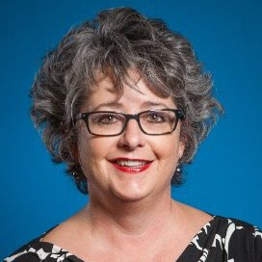
The Power of Your Brand – Leigh Farrow
Date: June 28, 2016
Time: 7:30-9:30am
Location: Seattle Comcast FFO
Cost: Free
Partnering w/Comcast Women’s Network

Slide 27
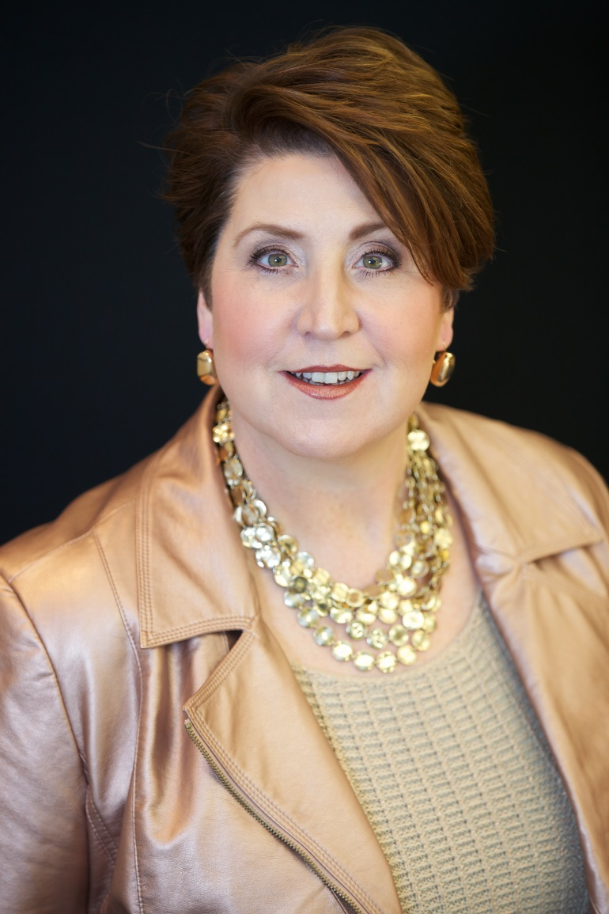
“The Confidence Effect” – Grace Killelea
Date: August 9, 2016
Time: 8:30-10am
Location: Heathman Hotel, Kirkland, WA
Cost: TBD

Slide 28
Creating Leaders. Together.
2017 PLANNING
2016 Mid-Year Retreat

Slide 29
Succession Planning
What did you find helpful in your onboarding to your position on the board?
What could we have done better to meet your expectations about preparing you for your board position and help you feel more successful in your role?
Your thoughts on potential future board members.
What are some events/programs that you want to work on in the next 12 months or are going to working on?
Key Timelines:
No later than August 2015: Notify Whitney, Kathleen, Joni if you need to transition off the board in 2017
September: Recruiting efforts completed and the 2017 Board Slate is solidified
October: Vote on the incoming board

Slide 30
2017 Retreat Planning
Which dates work best for you?
Thursday, December 15th
Tuesday, December 13th
Wednesday, December 7th
Thursday, December 8th
Expected location: Portland, OR

